Slide 1
TEACHER WELL-BEING AS A CRITICAL ELEMENT TO SUCCESS OF REMOTE LEARNING DURING THE PANDEMIC
Maria Perlita E. de Leon, RTI International
USAID | All Children Reading Philippines
Prepared for CIES Conference – 2022 (Minnesota)
This study was developed with the support from the American people through the United States Agency for International Development (USAID). The contents of this study are the sole responsibility of RTI International and do not necessarily reflect the views of USAID or the United States Government.

Slide 2

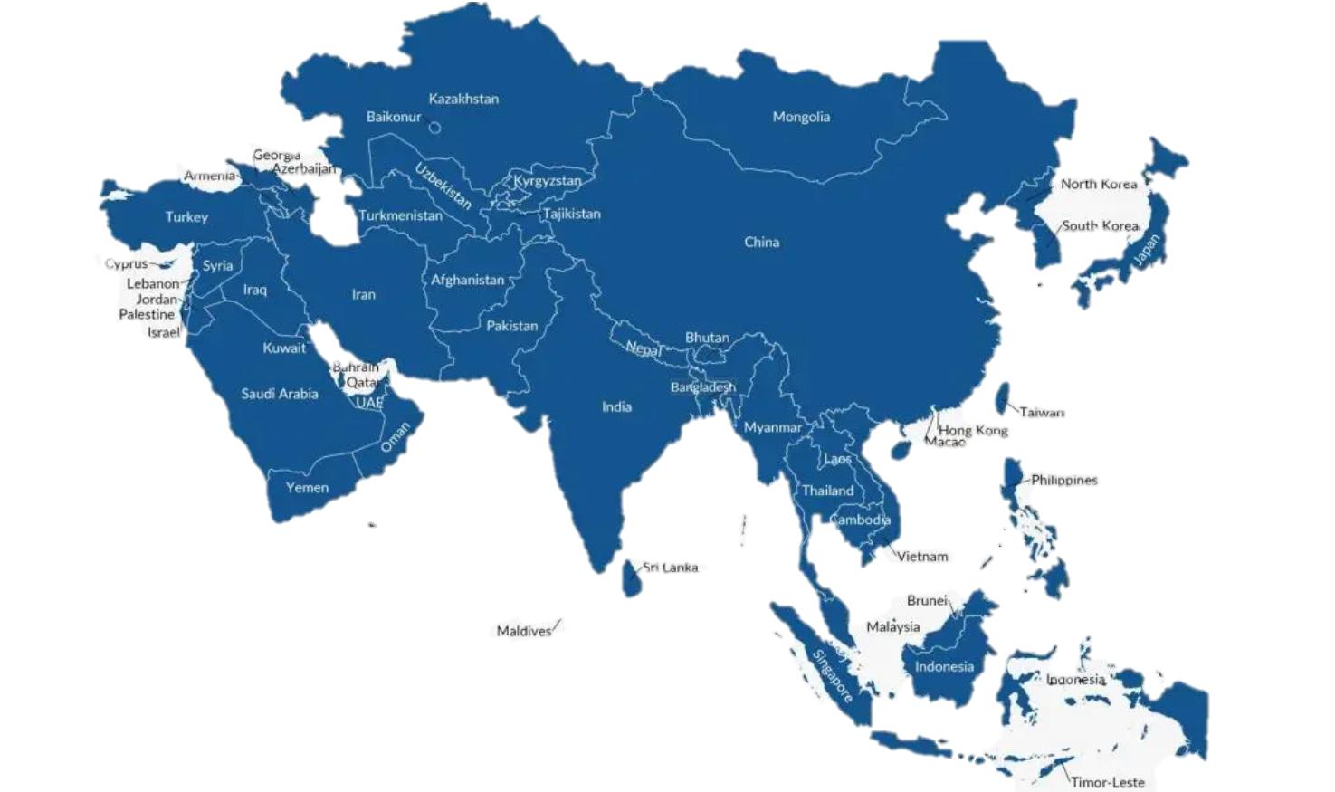

ALL CHILDREN READING – PHILIPPINES
Notes:
ACR–Philippines is part of the All Children Reading–Asia program implemented by RTI International across the Asia Region. The activities directly contribute to USAID’s education goal to improve early grade reading skills for 100 million children worldwide.

Slide 3
Supporting Early Grade Reading
Assessment and instruction
Use of education technology
Notes:
, Main areas of activity of ACR-Ph include
Early Grade Reading instruction and assessment in support of mother-tongue based multilingual education (MTB-MLE) and the
Use of educational technologies to support improved instruction in early grade reading, especially during school closures.
To do this, the project partnered with the Philippines Department of Education (DepEd) in improving reading outcomes for early grade learners with focus on impact, scale, and sustainability.
By building capacity and leadership of DepEd
Providing evidence through research to inform decision-making
and by providing technical assistance

Slide 4
REMOTE LEARNING STUDY
School leadership
Well-being
Continuity of learning
Notes:
One such activity is a study which was designed before the COVID-19 school closures. The plan was to investigate what elements of leadership, teaching and learning, and mother-tongue based multilingual education implementation best explained the performance outliers in Grade 3 reading before and after introduction of mother tongue as medium of instruction, based on findings from the 2013 to 2019 national Early Grade Reading Assessments (EGRAs).
The research objectives changed due to school closures and limited mobility in communities.
Focus shifted to a study of the remote learning experience of school actors; school heads, teachers, parents and other HLPs, and learners.
It then aimed at exploring how reading instruction is taking place during school closures, as well as aspects of school leadership support, well-being, and continuity of learning.
longitudinal mixed-methods study involving three data collections among the same participants from the 20 outlier schools.
Phone interviews and online surveys were conducted with the teachers.
Data collection took place in November 2020, March 2021, and June 2021.

Slide 5
TEACHER WELL-BEING
Protecting and fostering teacher well-being is vital to maintaining education quality, especially in challenging teaching context. (Beltman, Mansfield, & Price, 2011)
Teachers were closest to the issues but were insufficiently heard, supported, and valued. (Esteves, Buttimer, Farouki, Soukab, Fourkiller, Gutierrez, & Reich, 2021)
Notes:
The focus of this presentation is only on one aspect of remote learning and that is how teacher well-being supported the success of schools in their pivot to remote learning.
Many recent studies across the globe have seen that teachers’ mental health and well-being seemed to have declined throughout the pandemic because of the several challenges that they faced to make sure that education is accessible to the learners in the given context.
In the report of Esteves and colleagues for MIT Teaching Systems Lab

Slide 6
What impeded well-being
Difficulty connecting with school heads
Difficulty teaching and caring for the learners
Printing, reproduction, distribution, and retrieval of learning modules
Not knowing what the learners are doing and if they are learning.
Confidence and competence
Notes:
As we followed those 20 schools during the first year of remote learning we found similar and important patterns in the way teachers faced the challenges posed by the pivot to remote learning and their schools’ adaptation throughout the school year.
Because of limited access to technology and connectivity, many division offices opted for printed self-learning modules. Prior to the start of the school until the first quarter, teachers were scrambling to make sure that all modules are downloaded, printed, and reproduced. There were not always enough printing supplies and in many areas, modules are distributed late.
Community quarantine restrictions also limited teachers mobility and with unstable to no signal in many provinces, it was nearly impossible for teachers to reach their learners to know how they are coping.
This increased teachers anxieties because when modules come back, there were several instances that activities were completed by parents and not by the learners. It was apparent that home learning partners have low capacity to support learning at home.
Digital divide became very evident during the pandemic both among learners and teachers. Not all teachers and learners knew how to navigate technology and use them for teaching and learning, that is if they ever have devices to use.
With the changing roles among all school staff, especially in the school leadership, teachers found it even harder to connect and seek guidance—professionally and personally from their school heads.
With all of these things happening—teachers did not feel like they were teachers anymore and this hit them hard.

Slide 7





CHANGES OVER TIME…
Provide direct instruction
Give Instructional feedback
Provide remediation
Support parents & HLPs
Mobilize HLP network
Notes:
So obviously data form occasion 1 was rather bleak.
Keeping our fingers crossed that things will improve as the school year progressed, and true enough things began to change when teachers found their footing.
Across the three data collection timepoints we saw that the agency of many teachers allowed them to find ways to connect with their learners, ask how they are coping both with the pandemic situation and with remote learning.
There was increase frequency in direct instruction by way of home visits, school visits or online instructions or both especially in areas where lockdowns have eased.
There was increased frequency in giving direct feedback as well—written feedback on submitted assignments and modules, they used SMS or phone calls or both to families with access to cell phones.
As teachers continued to communicate with the learners and their families, they were able to better identify those who are struggling and needed more support or remediation. And this allowed them to strategize and provide remediation to the learners and guide their parents on supporting home learning.
They mobilized parent networks to support home learning partners who have low capacity to guide their learners (especially those who have low literacy capacity)
Connecting to the learners and their families and being able to deliver instruction again, have contributed immensely in the teachers’ well-being in ways that helped schools cope with remote learning.

Slide 8
Four Levels of Success in Implementing the Remote Learning Program
Level 1. Poor Initial Transition, No Adaptations.
Level 2. Challenged Initial Transition, Small Adaptations.
Level 3. Challenged Initial Transition, Major Adaptations.
Level 4. Challenged Initial Transition, Major Adaptations.
Teachers’ and school adaptations matter
TEACHER WELL BEING DURING THE PANDEMIC – CIES 2022 PRESENTATION
Notes:
In this slide is our characterization of the participating schools’ success in implementing remote learning in the school year 2020-2021 and how teachers and schools’ adaptations contributed to their success level
Level 1. Poor Initial Transition, No Adaptations. Schools struggled to transition to remote learning and demonstrated little evidence of improvement over the school year, and therefore, negligible support for continuity of learning was provided.
The teachers were hardly ever able to make any adjustments outside of printing, reproducing, distributing and getting back the self-learning modules.
There seemed to be minimal and even no effort or initiative to try and reach out and support learners and their families.

Slide 9
Four Levels of Success in Implementing the Remote Learning Program
Level 1. Poor Initial Transition, No Adaptations.
Level 2. Challenged Initial Transition, Small Adaptations.
Level 3. Challenged Initial Transition, Major Adaptations.
Level 4. Challenged Initial Transition, Major Adaptations.
WE’VE NOT REALLY ADJUSTED. IT'S LIKE WE ARE IN SHOCK.
Teachers’ and school adaptations matter
Notes:
At the end of the school year, teachers…

Slide 10
Four Levels of Success in Implementing the Remote Learning Program
Level 1. Poor Initial Transition, No Adaptations.
Level 2. Challenged Initial Transition, Small Adaptations.
Level 3. Challenged Initial Transition, Major Adaptations.
Level 4. Challenged Initial Transition, Major Adaptations.
Teachers’ and school adaptations matter
Notes:
Level 2. Challenged Initial Transition, Small Adaptations. These schools struggled to transition to remote learning initially but demonstrated some special qualities and/or made small but important adaptations, which helped support implementation.
Teacher stayed connected to and support learners. at least once per week and augmented literacy materials with activity sheets, additional stories, and materials appropriate to different abilities.
The ability of teachers to make home visits and engage directly with HLPs and learners made a difference in their appreciation of the role of the parent in distance learning.
Teachers also received some instructional guidance form the school head

Slide 11
Four Levels of Success in Implementing the Remote Learning Program
Level 1. Poor Initial Transition, No Adaptations.
Level 2. Challenged Initial Transition, Small Adaptations.
Level 3. Challenged Initial Transition, Major Adaptations.
Level 4. Challenged Initial Transition, Major Adaptations.
  “WITHOUT THE ASSISTANCE OF PARENTS, I DON’T THINK ANY OF THE PROGRAMS I MENTIONED WOULD WORK.”
Teachers’ and school adaptations matter
Notes:
In these schools, close communication and partnership between teachers and parents were highlighted

Slide 12
Four Levels of Success in Implementing the Remote Learning Program
Level 1. Poor Initial Transition, No Adaptations.
Level 2. Challenged Initial Transition, Small Adaptations.
Level 3. Challenged Initial Transition, Major Adaptations.
Level 4. Challenged Initial Transition, Major Adaptations.
Teachers’ and school adaptations matter
Notes:
Level 3. Challenged Initial Transition, Major Adaptations. All the things that level 2 schools, they did and more which helped maximize continuity of learning.
There were Teacher-driven adaptations to mitigate module inadequacies, by strategically reducing content and by providing supplementary materials like:
Augmenting materials with pictures, folk stories, song lyrics, and poems
Downloading and distributing materials from the DepEd Commons which is a repository of learning materials
Making suggestions for educational programs on YouTube and television
Video-taping demonstration lessons to share with HLP.
Frequent and regular communications with parents and other HLPs and they accommodated different learning needs
The school heads supported the teachers in ways they never did before – established partnerships with external stakeholders, and provided not only professional but also psychosocial support to the teachers and HLPs

Slide 13
Four Levels of Success in Implementing the Remote Learning Program
Level 1. Poor Initial Transition, No Adaptations.
Level 2. Challenged Initial Transition, Small Adaptations.
Level 3. Challenged Initial Transition, Major Adaptations.
Level 4. Challenged Initial Transition, Major Adaptations.
  LIMITED ACCESS TO TECHNOLOGY AND CONNECTIVITY SLOWED DOWN SCHOOL ADJUSTMENT
Teachers’ and school adaptations matter
Notes:
Teachers did everything they could,

Slide 14
Four Levels of Success in Implementing the Remote Learning Program
Level 1. Poor Initial Transition, No Adaptations.
Level 2. Challenged Initial Transition, Small Adaptations.
Level 3. Challenged Initial Transition, Major Adaptations.
Level 4. Challenged Initial Transition, Major Adaptations.
Teachers’ and school adaptations matter
Notes:
Level 4. Challenged Initial Transition, Major Adaptations. These schools did everything that level two and level three schools did but they have better access to technology and connectivity which allowed them to putting into place changes to the remote learning program during the initial part of the year—leading to a quick and effective transition to remote learning—and continued to improve and adapt to the situation in major ways, maximizing continuity of learning at home.

Slide 15
Four Levels of Success in Implementing the Remote Learning Program
Level 1. Poor Initial Transition, No Adaptations.
Level 2. Challenged Initial Transition, Small Adaptations.
Level 3. Challenged Initial Transition, Major Adaptations.
Level 4. Challenged Initial Transition, Major Adaptations.
  ACCESS TO TECHNOLOGY, EFFECTIVE PARTNERSHIPS, AVAILABILITY OF RESOURCES, AND COLLABORATIVE LEADERSHIP EMPOWERED TEACHERS
Teachers’ and school adaptations matter
Notes:
Other than technology, Teachers were included in decision making and this made a lot of difference in their sense of autonomy and well-being
Where there are systems that supported teachers to reach out to the learners and their families and be able to deliver learning in a timely and effective manner, one could hardly hear any mention of challenges. During interviews, it felt like teachers from these schools had this adrenaline rush to deliver learning where it is most needed.

Slide 16



LESSONS AND PRACTICAL IMPLICATIONS
  Partnerships with parents
  New technology
  Teacher-learner connection
  Professional connections
  School leadership
Notes:
It is not to say that ONLY teachers’ well-being contributed to the success of schools during remote learning. But this allowed many schools to succeed though at different phases. What we learned from this research there were factors that allowed them to exercise agency to keep learning going even when nobody could physically go to school.
We recommend that school heads and teachers work together to ensure that these positive parent experiences in supporting their children’s learning will continue as learners return to the classroom. This is good for not only children’s academic learning but for their psycho-social well-being and social emotional learning as well.
It will take a concerted effort, collective school leadership and teamwork, to strategically leverage these new technical skills and communication technologies into education programs when schools open, but will be worth the investment so teachers can create alternative means of learning delivery, engage in professional development activities, and have a venue to discuss and resolve issues and provide mutual support to one another..
Study findings also underscored the critical importance of teachers staying connected to their learners. It is recommended that school heads and teachers work together to help children reconnect and rebuild their sense of belonging when they return to the classroom and support learners’ social and emotional well-being and minimize any anxiety children may feel about returning to school.
Study findings also emphasized the value of regular communications and collaborative leadership between teachers and school heads. Thus, we recommend to continue and strengthen professional networks established as schools open and to leverage communication technologies advanced during the first year of remote learning to support regular teacher-parent and intra- and inter-professional communications.

Slide 17
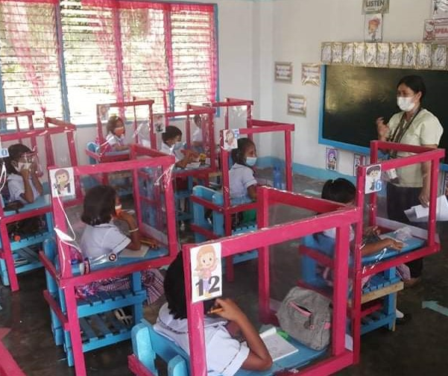
Discussion Question:
What did we learn from remote learning that we could improve to support teachers, learners, and home learning partners’ well-being now that schools are progressively returning to face-to-face set up?

Slide 18

Thank you!
Maria Perlita E. de Leon
mdeleon@rti.org

